Slide 1
Frequency Distributions
Chapter 2

Slide 2
Descriptive Statistics
Distributions are part of descriptive statistics…we are learning how to describe some data by first graphing it in a meaningful way

Slide 3
Descriptive Statistics
Frequency distribution – describes the pattern of a set of numbers by displaying a count/percent for the values of the variables

Slide 4
Frequency Distributions
Four different ways to visually describe just one variable:
Frequency table
Grouped frequency table
Frequency histograms
Frequency polygon

Slide 5
Frequency Tables
Frequency tables often include:
Values (all the possible numbers)
Frequency (how many times each number appears)
Percent/proportion
Why percent when we have frequency?

Slide 6
Frequency Tables
Grouped frequency tables are frequency tables where information has been clumped together
For example, ABCD breakdowns instead of each grade individually. Or income ranges rather than each income separately.
Very useful for data with decimals and wide ranges of values.

Slide 7
Installing JASP
JASP is the FREE statistics program we will be using to analyze our data this semester!
Step by step guide is in Blackboard under “JASP Information”
Also access to the step-by-step guide through this OSF link:
https://mfr.osf.io/render?url=https://osf.io/rquv8/?action=download%26mode=render

Slide 8
Installing JASP
Go to this website
https://jasp-stats.org/
Click “Download JASP”
Click “Download JASP for ___” whatever your operating system is
Windows should download like normal
Some weird stuff with Macs, but the guide will go through all of that

Slide 9
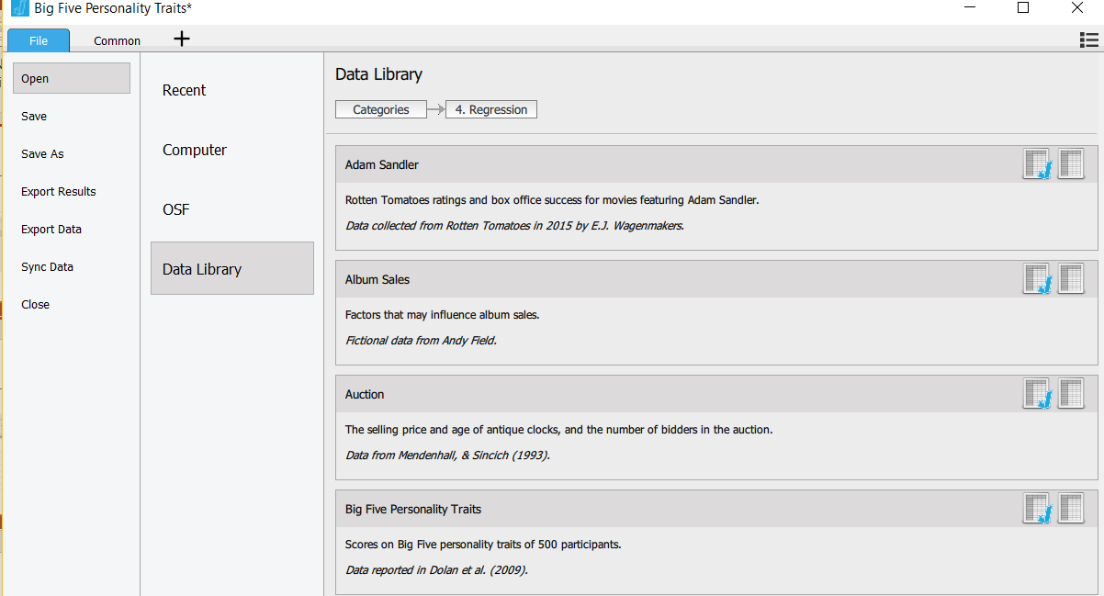
How-To JASP
Open JASP → Open your data set (Data Library → Regression → Big Five)

Slide 10
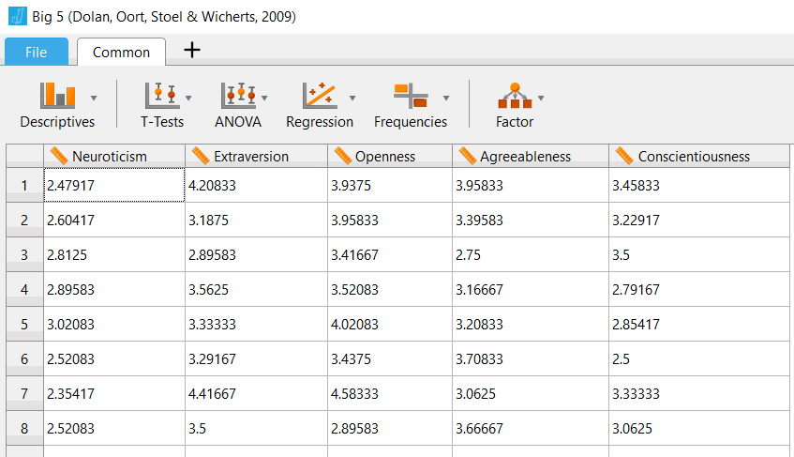
How-To JASP
Select descriptives → descriptive stats

Slide 11
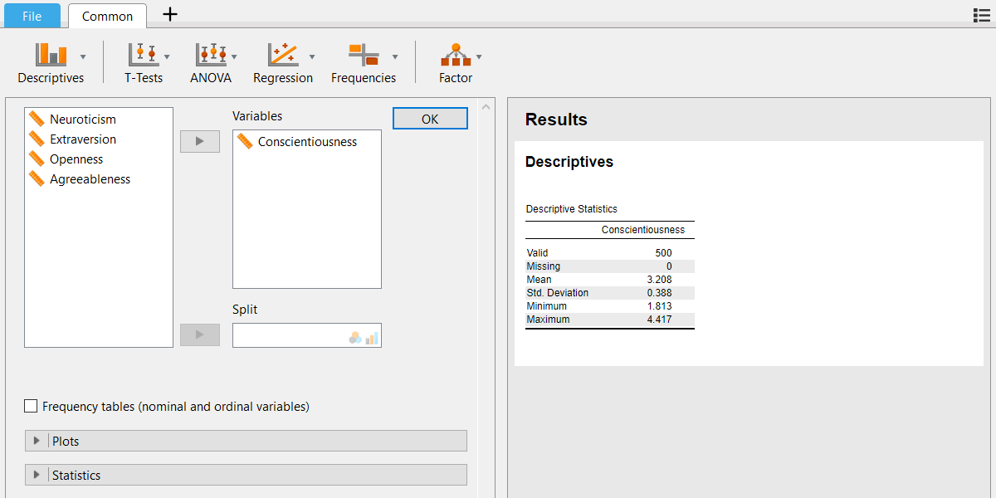
How-To JASP
Select the variables you want

Slide 12
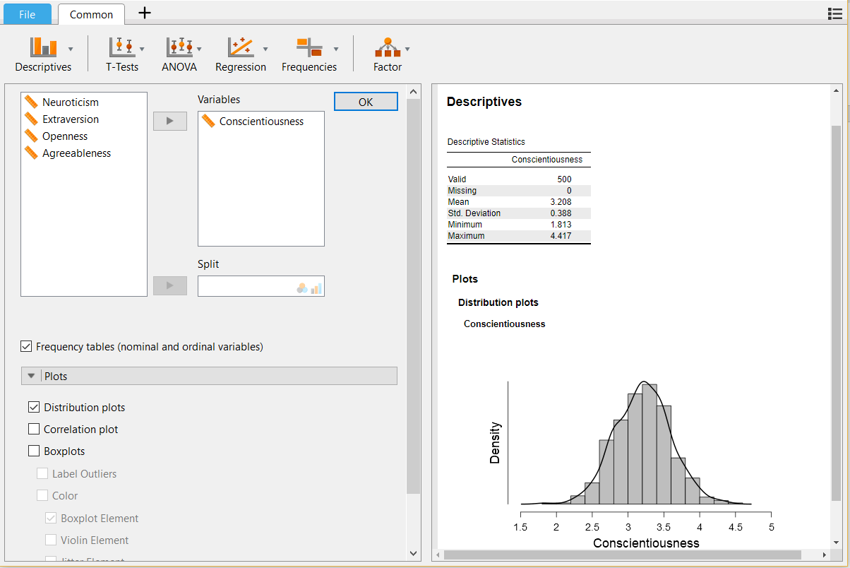
How-To JASP
Select frequency tables and distribution plots

Slide 13
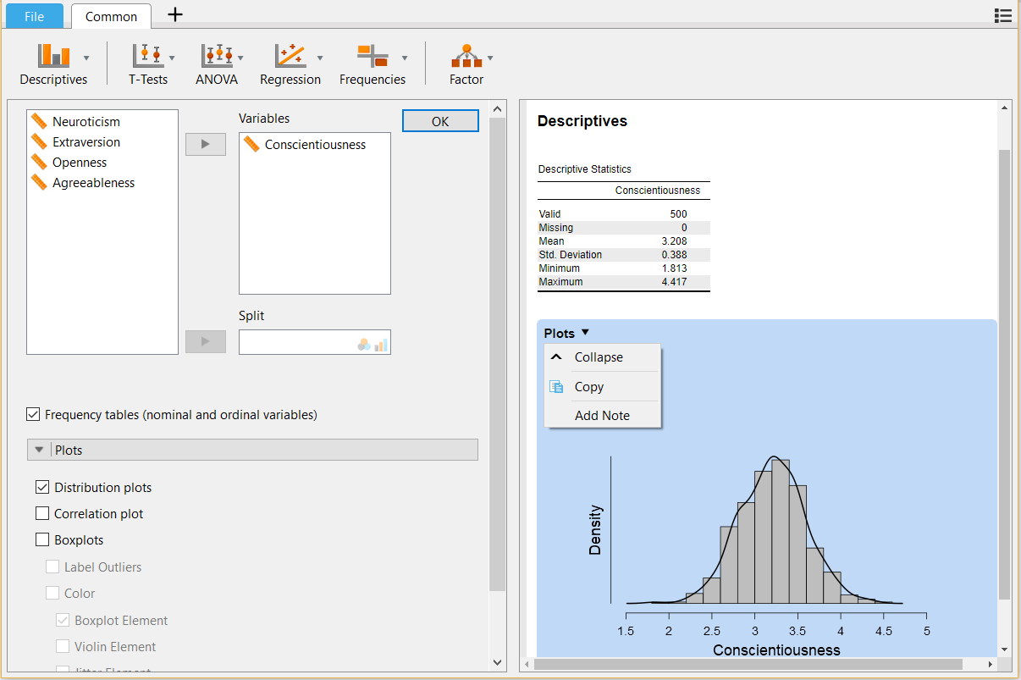
How-To JASP
Copy the plot and paste it in word

Slide 14
Histograms
Histograms are frequency tables in graph form (basically they are turned on their side and made into a chart).
Gives you an idea of the shape of the distribution.

Slide 15
Frequency Polygon
Frequency polygons are histograms that show a smoothed line instead of the bars for a histogram.
So why use these?
They often give you a better picture of the data, since histograms can be changed based on binwidth (more on this idea in a minute).

Slide 16
Shapes of Distributions
Unimodal
(normal distribution)
Bimodal
Multimodal
Rectangular

Slide 17
Shapes of Distributions
Normal distributions: Specific frequency distribution
Bell shaped
Symmetrical
Unimodal

Slide 18
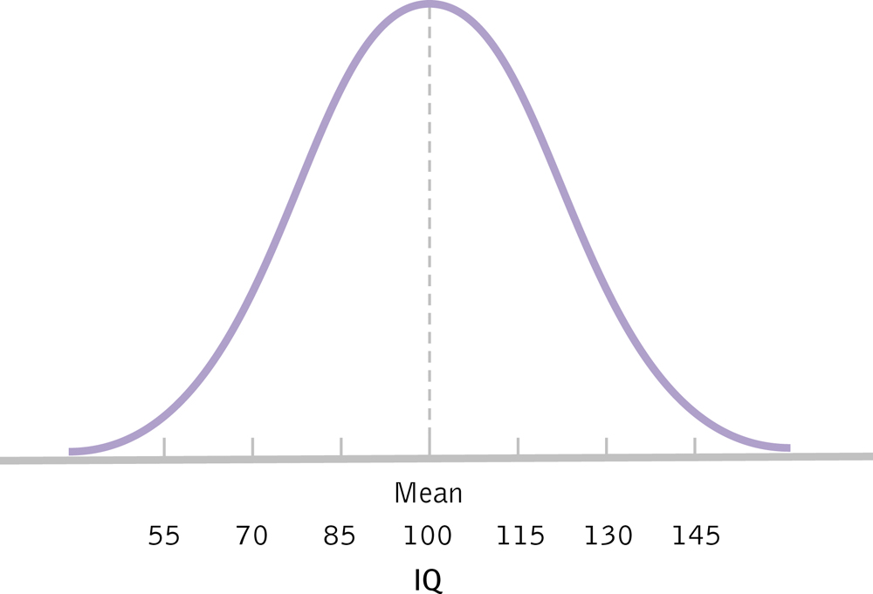
The Normal Distribution

Slide 19
Skewed Distributions
When our data are not symmetrical
Positive: tail to the right
May represent floor effects
Negative: tail to the left
May represent ceiling effects
Memory hint: skew is where the tail is (the cat!)

Slide 20
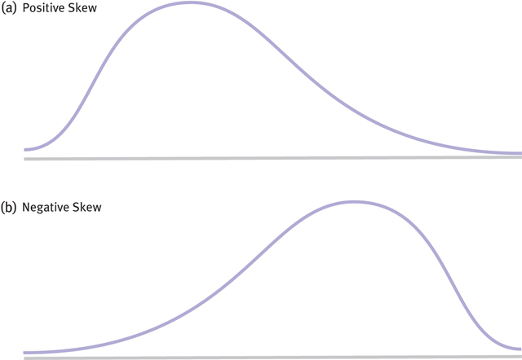
Two Kinds of Skew

Slide 21
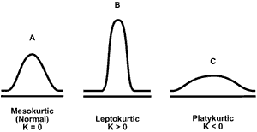
Kurtotic Distributions
Kurtosis – how much a distribution deviates from normal by looking at spread

